Slide 1

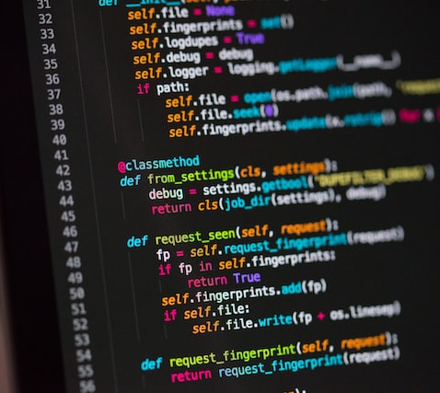


Secure Password Generator
Team Members: Xavier Scott
Main concept: This application will generate secure passwords for users that contain a mix of characters and meet password length requirements. Users will have the option to generate as many passwords as they wish.
My Github Repository: https://github.com/ksu-is/Secure-Password-Generator
Source Github Respository: https://github.com/xavier7115/password-generator-forked

